Slide 1


Smart Cigarette Tracking Device
Group Number - 5
SE-IoT, Summer 2021
Baki Can Öztepe
baki.oeztepe@hof-university.de
Gohith Sai Kanchinatham
gohith.kanchinatham@hof-university.de
Ranjib Kumar Raj
ranjib.raj@hof-university.de
Vibhu Badola
vibhu.badola@hof-university.de

Slide 2

Contents
Problem Statement
Project Specification
Hardware Diagram
Circuit Schematic and Connection Overview
Cloud Integration
Proof of Concept
Takeaway

Slide 3


Problem Statement
Problem?
Worldwide around 780 million people want to quit, but only 30% can do so.
Addicted people forgot the count of cigarette they have consumed.
Leads to harm the body.
Leads to harm the others also.
2. Problem occurrence?
Worldwide issue.
3. Why does it occur?
Nicotine - This chemical signal brain to feel more energized.
Nicotine alters the chemical functions in our brain.
It causes some disease to the body like hearing loss, increased risk of lung disease , heart attack.

Slide 4

Problem Statement Cont..
4. Who does the problem affect?
To the person who smoke.
To the environment
To other people those are non-smoker with Secondhand Smoke.
5. Negative effects of problem?
Smoking not only effect to the person who smokes but also to others.
Causes lung cancer, stroke, higher blood pressure, DNA damage and so on.

Slide 5
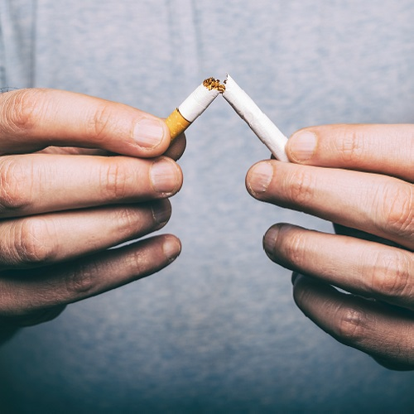
Problem Statement Cont..
6. Why should we care about the problem?
To help those who want to quit smoking.
To help ourself and coming generation.

Slide 6
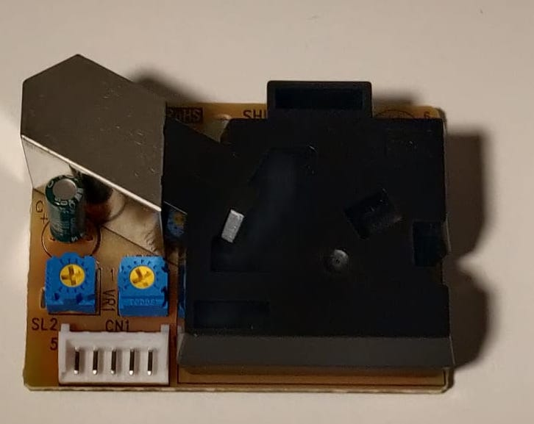
Project Specification
Grove - Dust Sensor (PPD42NS)
The Sensor will trigger IFTTT event, if the sensor reading is more than 1500 particles per cubicle feet.
The sensor should be kept in upright position for better results.
For better accuracy, the sensor should be kept on 3 minutes, before being considered for collecting Sensor Data
Sensing Requirements

Slide 7
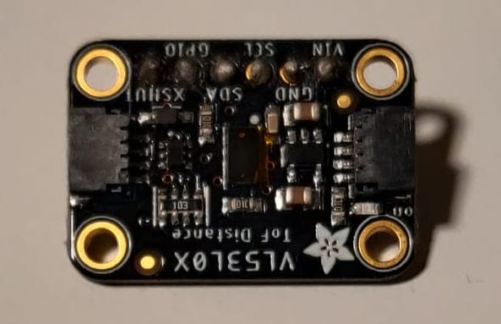
Adafruit VL53L0X ToF Sensor
Sensing Requirements
For Triggering the IFTTT event, the distance between the human body and sensor should be more than 180mm.
The SCL pin should be connected to G33 pin of M5StickC
The SDA pin should be connected to G32 pin of M5StickC
The sensor contains a very tiny invisible laser source.
The VL53L0X can detect the "time of flight", or how long the light has taken to bounce back to the sensor.
The sensor can measure approximately 30mm to 1.2 meter in default mode.

Slide 8
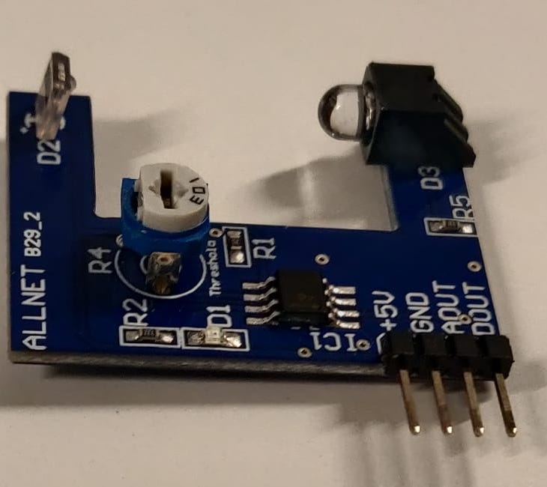
ALLNET B29_2 Pulse Sensor
Sensing Requirements
The IFTTT event will be triggered when the pulse of the person in subject is 88 beats per minute.
For our project, we are using AOUT pin, It is the direct measure of the sensor value.
The Sensor has two LEDs.
LED1: Indicates that the sensor is supplied with voltage.
LED2: Indicates that the heartbeat has exceeded the limit value.

Slide 9
Sensor types, which are applicable for this project.
SH200Q
6 axis IMU Sensor, to detect 3-axis Gyro data and 3-axis acceleration data. It is present inside M5StickC.
The arm motion of the smoker can be recorded and compared with the pre-recorded data to determine if the motion is indeed the act of smoking. This can be done by measuring the acceleration and rotation of the subject’s wrist.
2. SPM1423 Microphone
This sensor can be used to record the clicking sounds of a cigarette lighter.

Slide 10
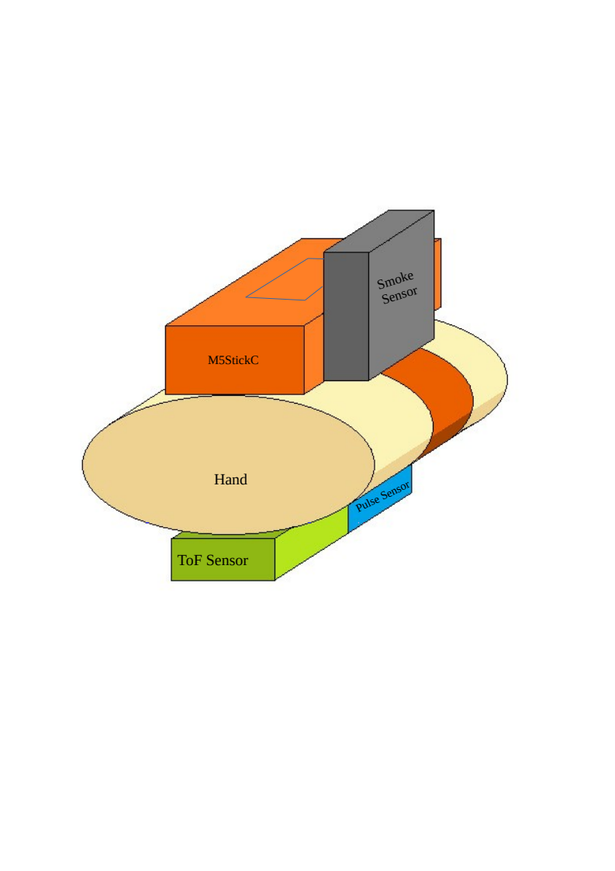
Hardware Diagram
This whole product was designed to embed on top of wrist of a person
M5StickC Placed on top as it meant to be along with Grove Smoke Sensor
Time of Flight Sensor and AllNet 4Duino Pulse sensor was placed at bottom of hand
This sensor placement is done such a way to get optimum result
9/27/2023
Master SE - Hof University of Applied Sciences
10

Slide 11
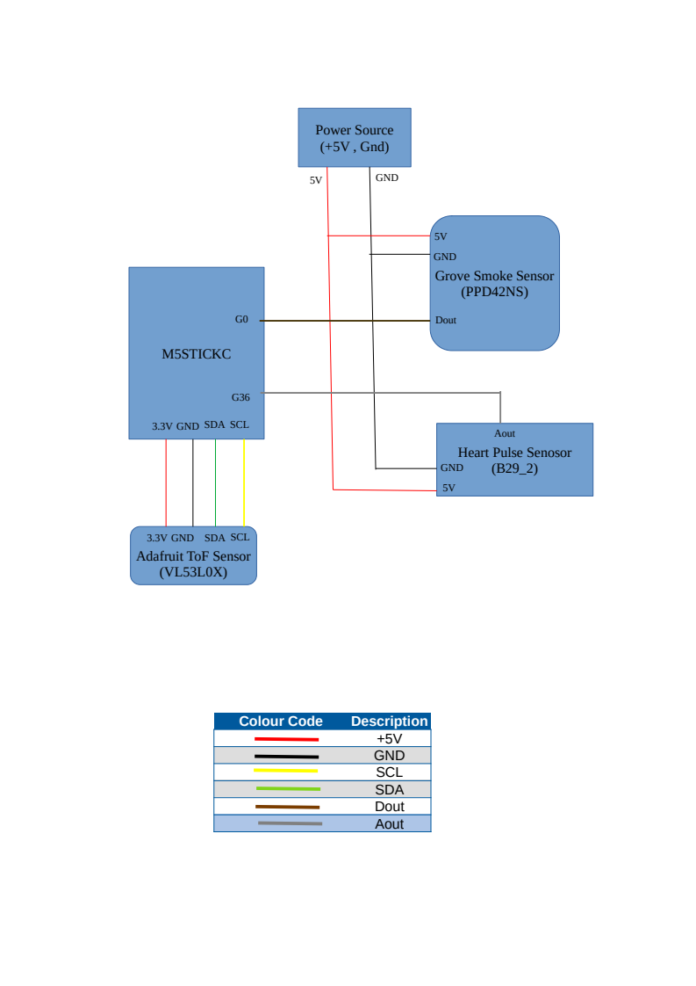
Circuit Schematic and Connection Overview

Slide 12
Brief Explanation of terminology
I2C is also called Two Wire communication protocol
I2C can be used with one master and upto 128 slaves
It was invented by philips Semiconductors in 1982
M5StickC pin 36 and GPIO 25 was internally shorted, to reduce noice we can use PullUp concept
Even though most pins of ESP32 are having voltage-in tolerance of 3.3V, but still few pins can tolerate upto 4.6V level that includes (GPIO 0 and GPIO 36)

Slide 13

Cloud Integration
IFTTT cloud services.
If This Than That
For example - If we press a button in M5 StickC, then a log of that button press is added to a Google spreadsheet.
It’s a cloud base service that interact with other services.
IFTTT helps all our apps and devices to work better together.
Applets - It connects two or more apps or devices together.
Webhook Service – It is a way for an app to provide other apps with real-time information.

Slide 14
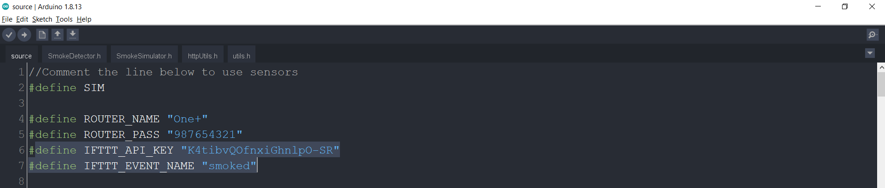
Cloud Integration Cont..
2. Data Processing on the M5StickC

Slide 15
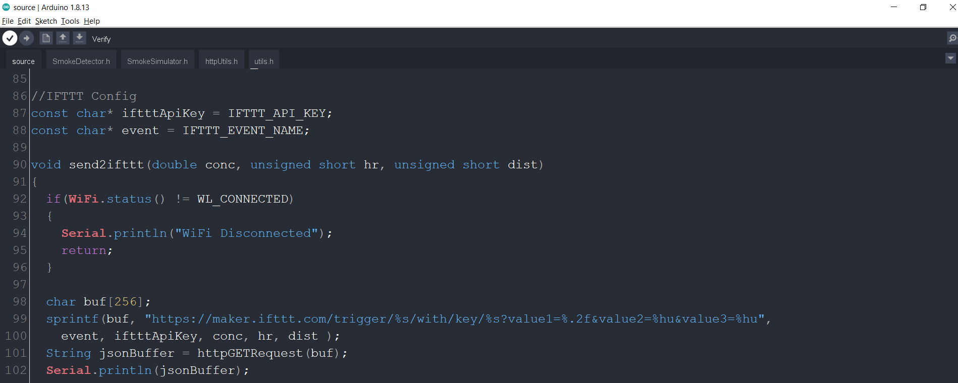
Cloud Integration Cont..
2. Data Processing on the M5StickC

Slide 16
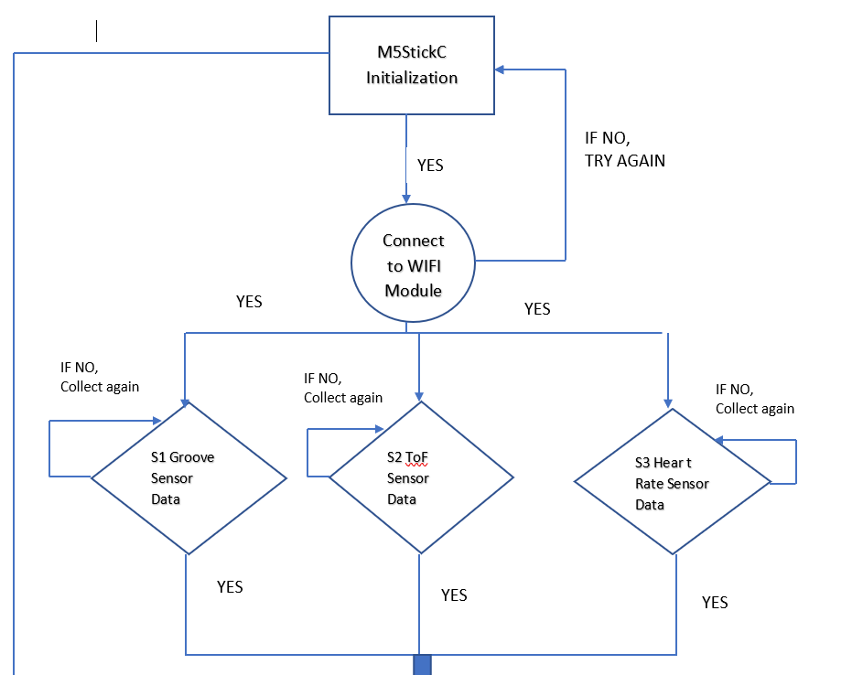
Cloud Integration Cont..
3. Interaction Diagram

Slide 17
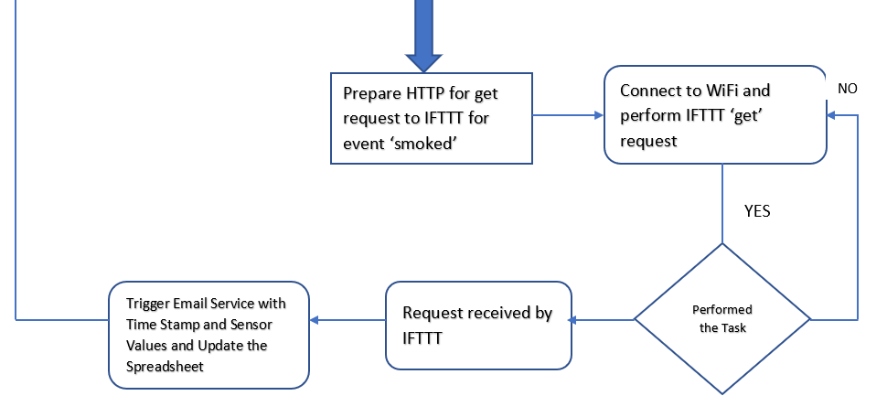
Cloud Integration Cont..
3. Interaction Diagram Cont..

Slide 18
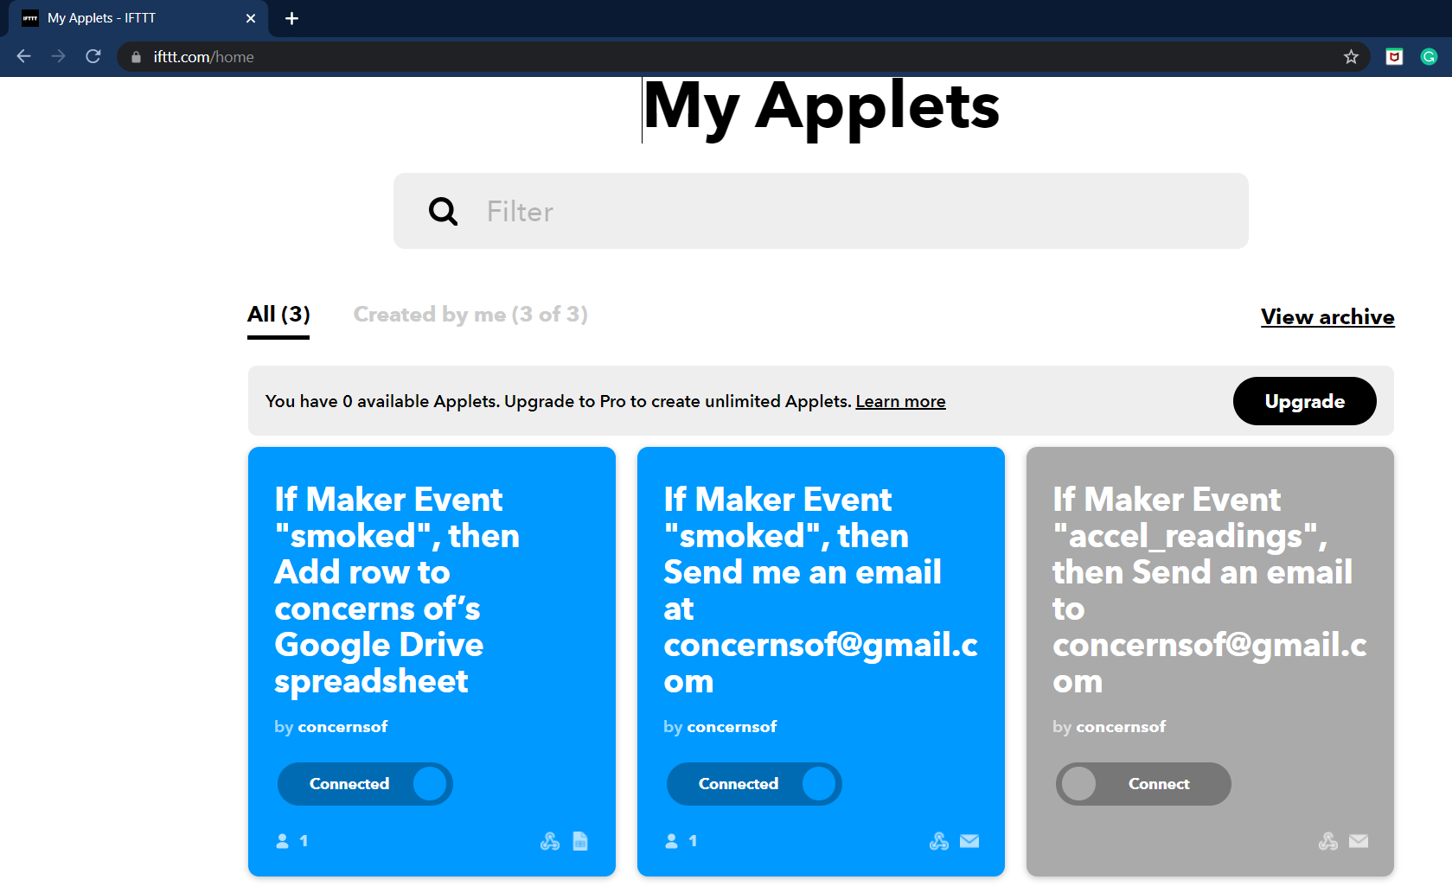

Cloud Integration Cont..
4. Data Sent to Cloud, Formatted and presented to end-user.

Slide 19
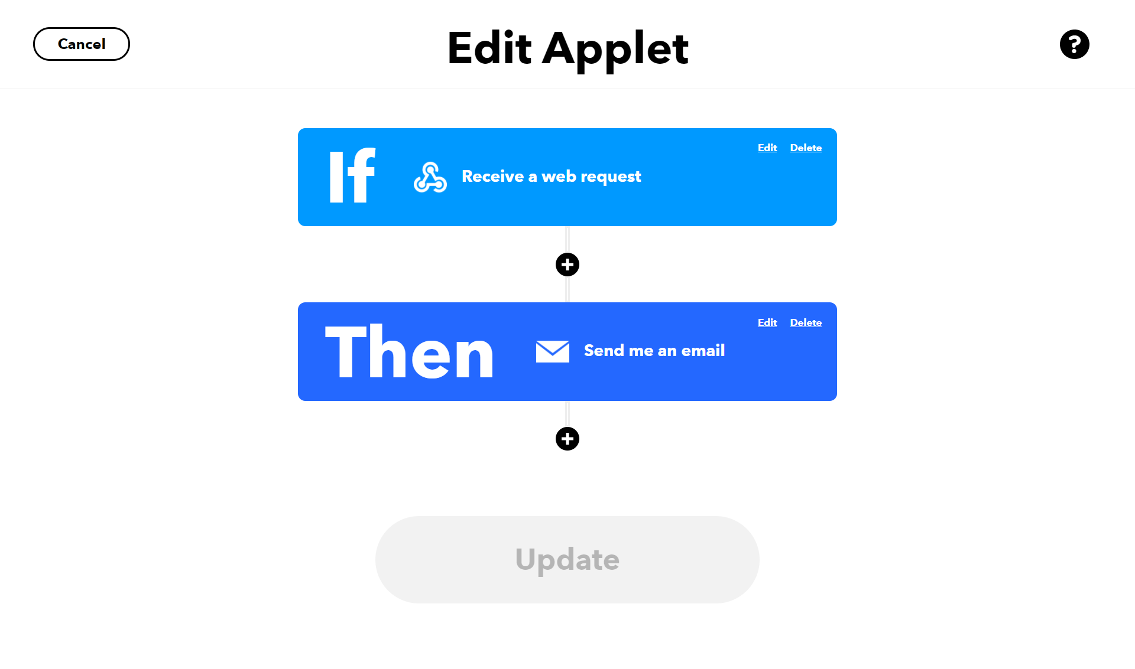
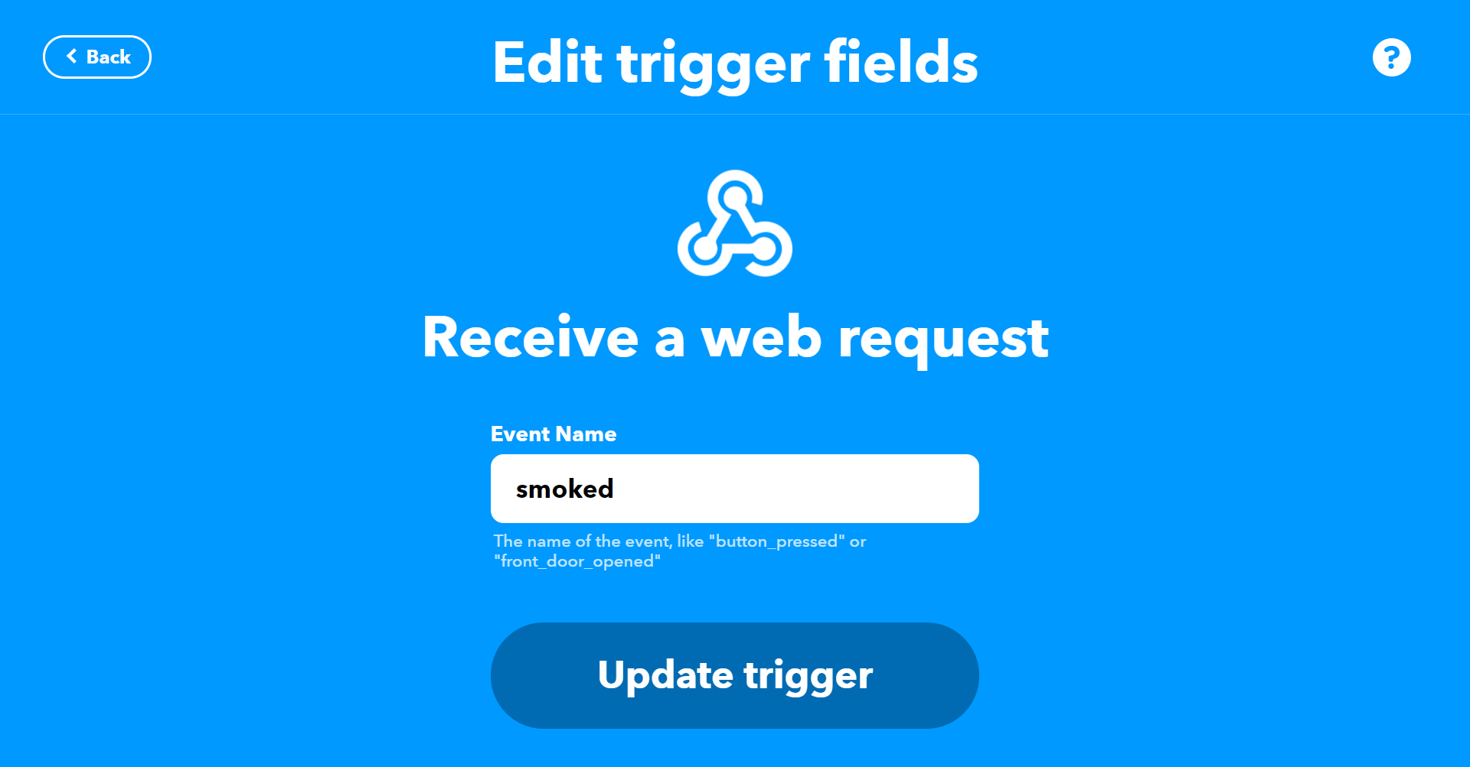
Cloud Integration Cont..
4. Data Sent to Cloud, Formatted and presented to end-user.

Slide 20
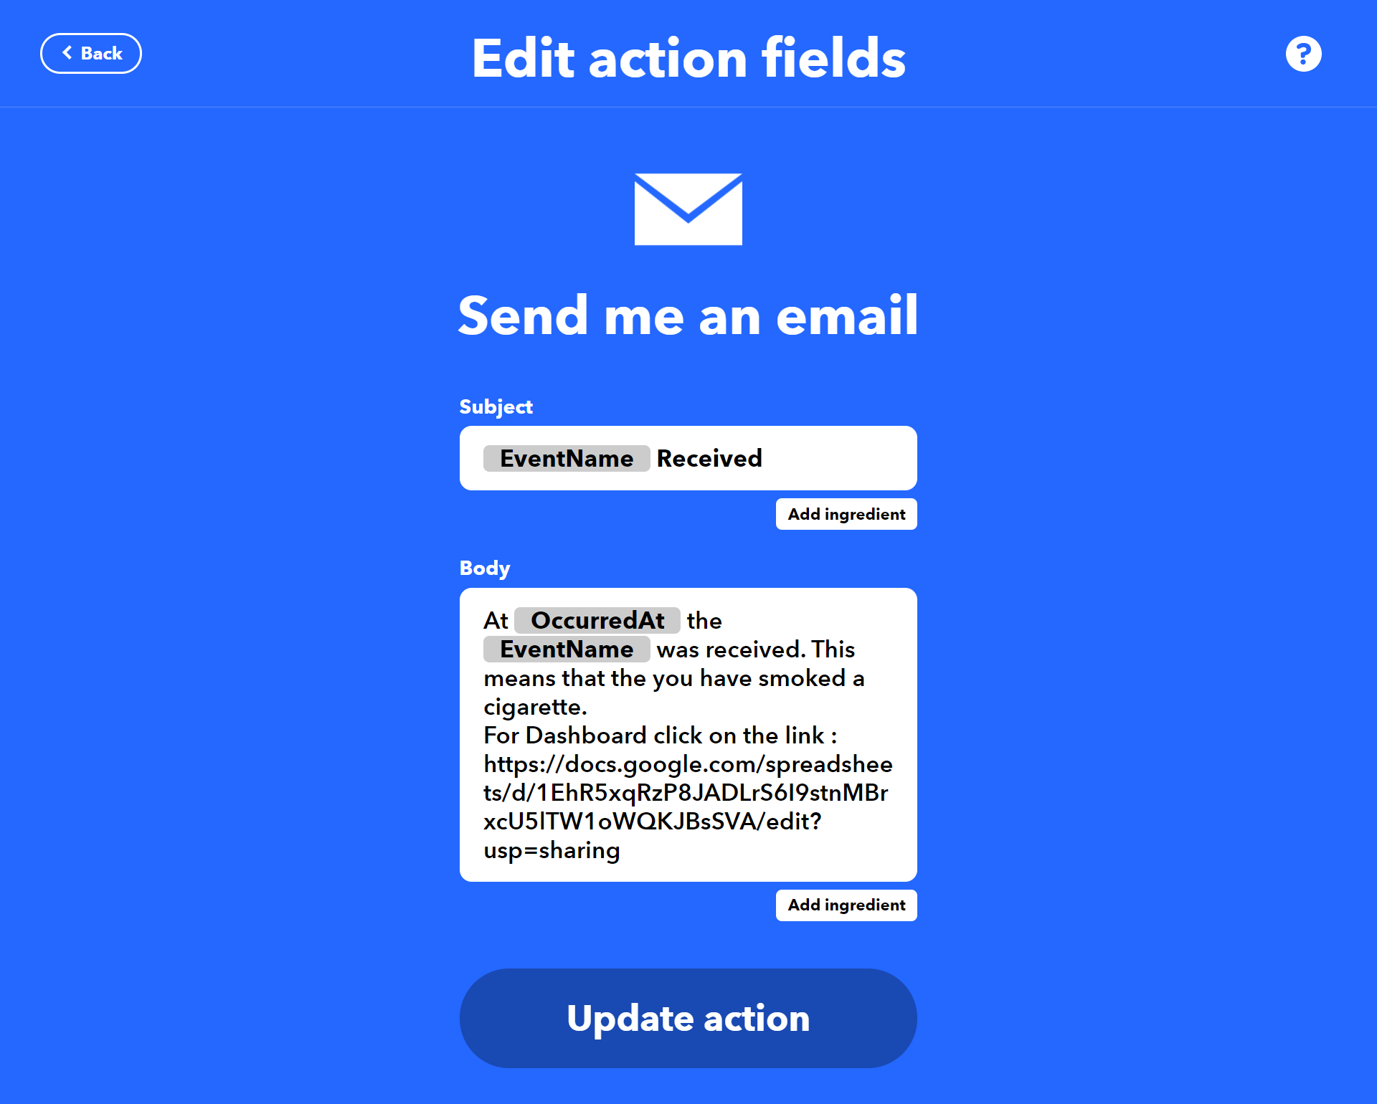
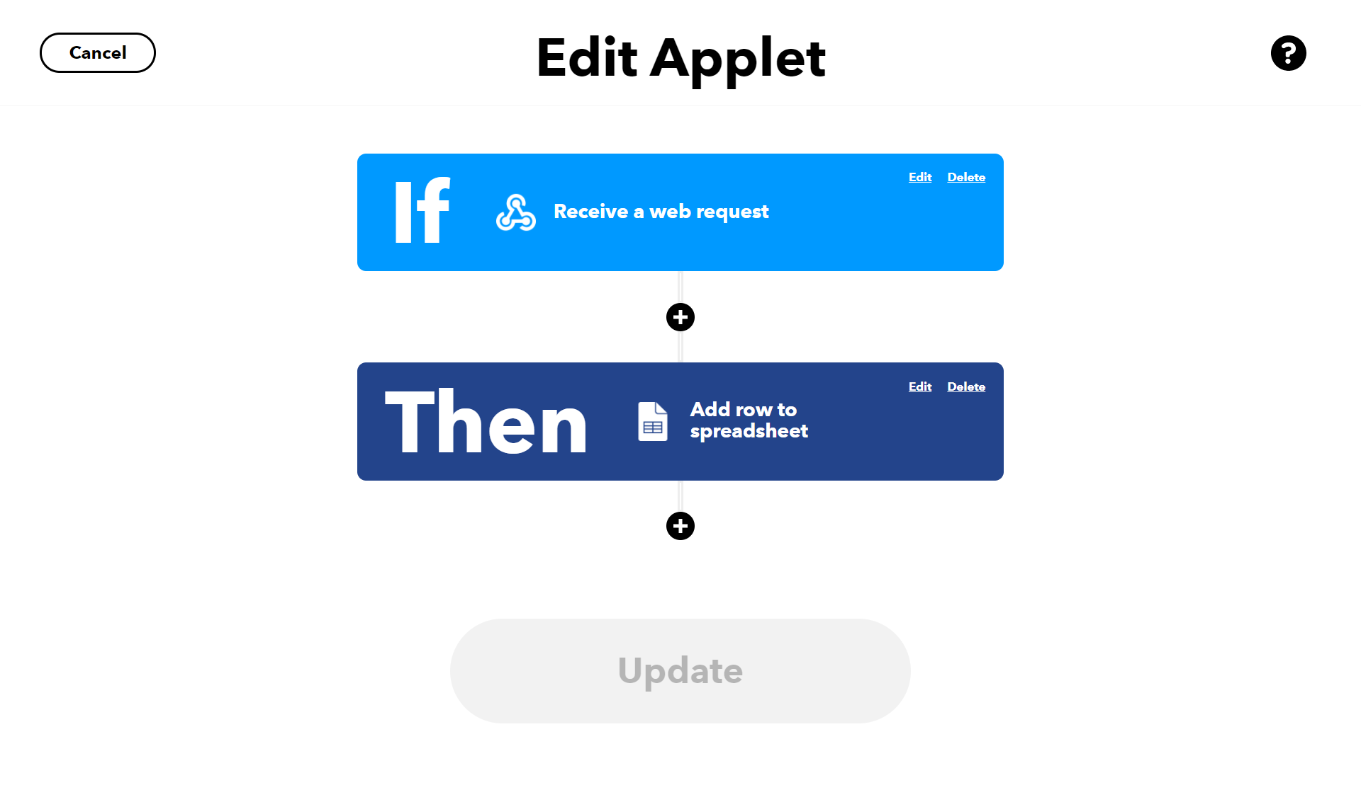
Cloud Integration Cont..
4. Data Sent to Cloud, Formatted and presented to end-user

Slide 21
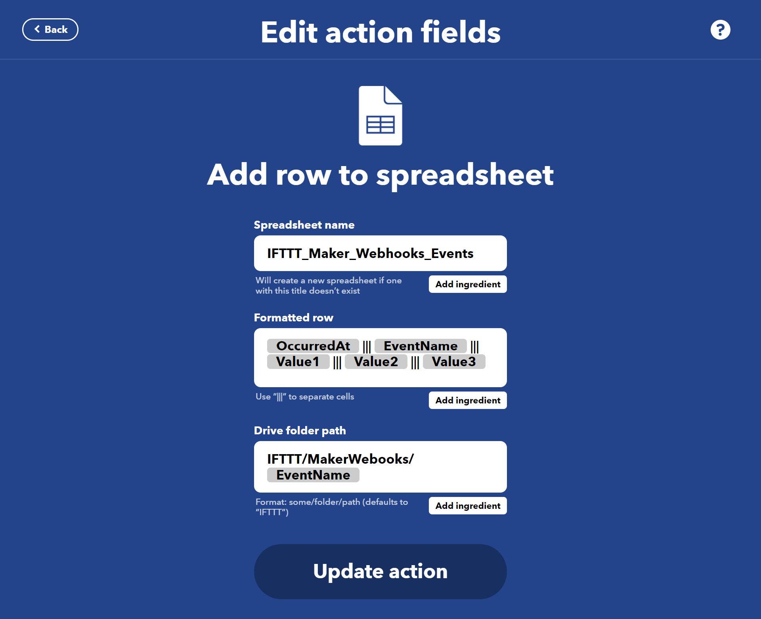
Cloud Integration Cont..
4. Data Sent to Cloud, Formatted and presented to end-user

Slide 22
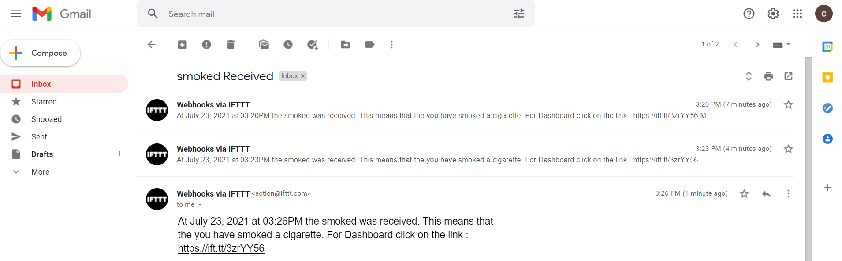
Cloud Integration Cont..
4. Data Sent to Cloud, Formatted and presented to end-user

Slide 23
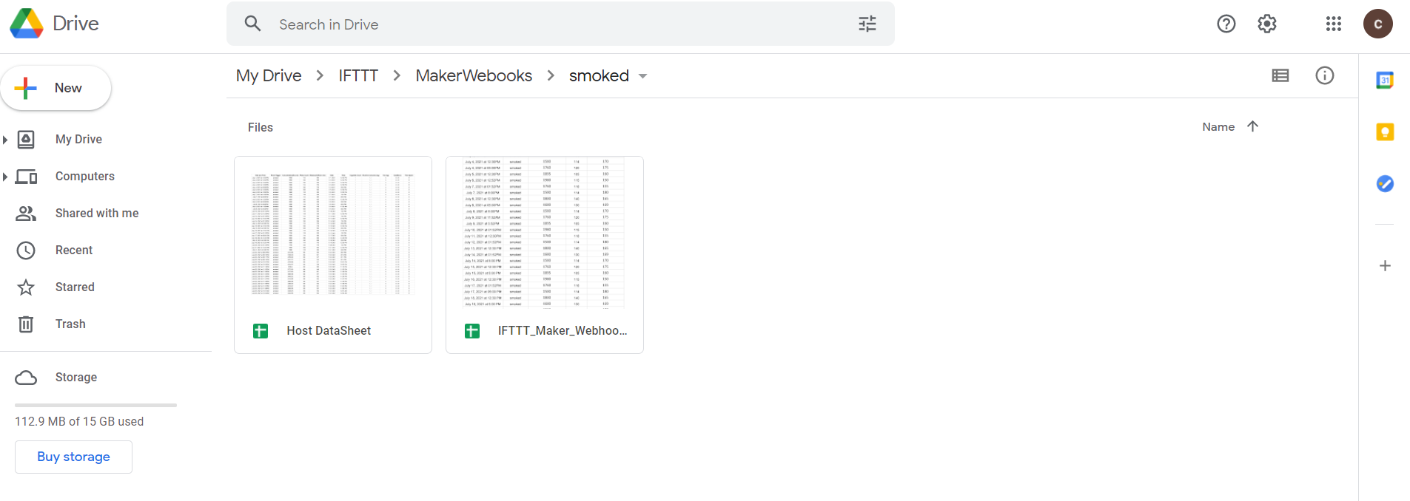
Cloud Integration Cont..
4. Data Sent to Cloud, Formatted and presented to end-user

Slide 24
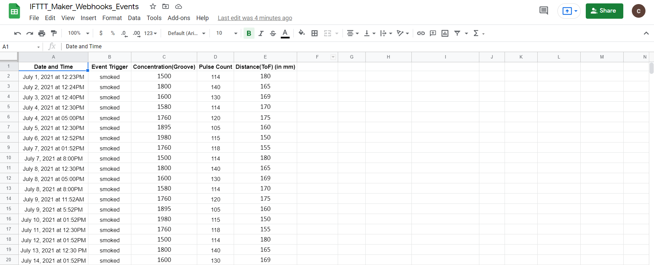
Cloud Integration Cont..
4. Data Sent to Cloud, Formatted and presented to end-user

Slide 25
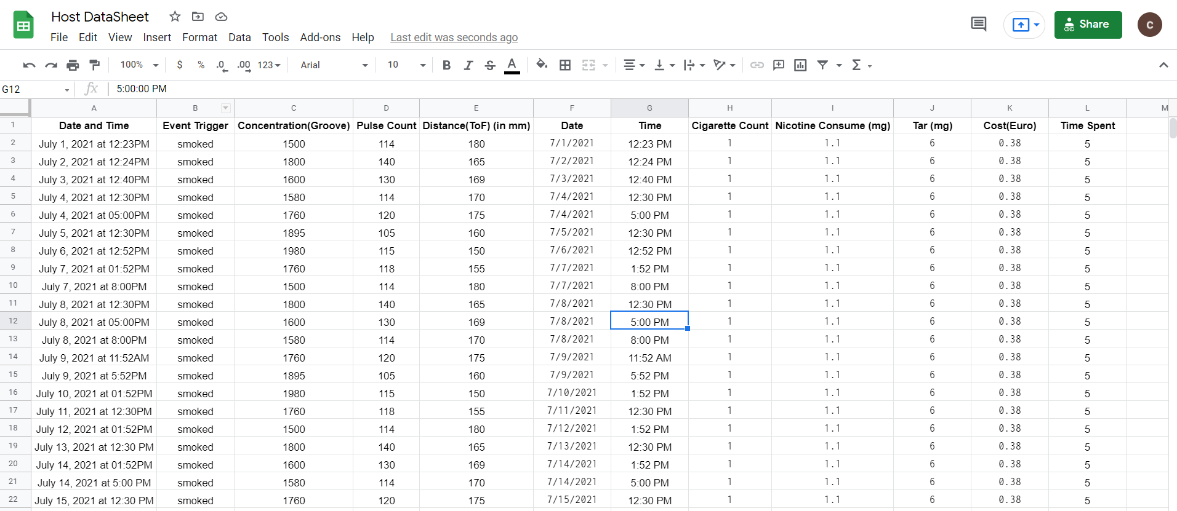
Cloud Integration Cont..
4. Data Sent to Cloud, Formatted and presented to end-user

Slide 26
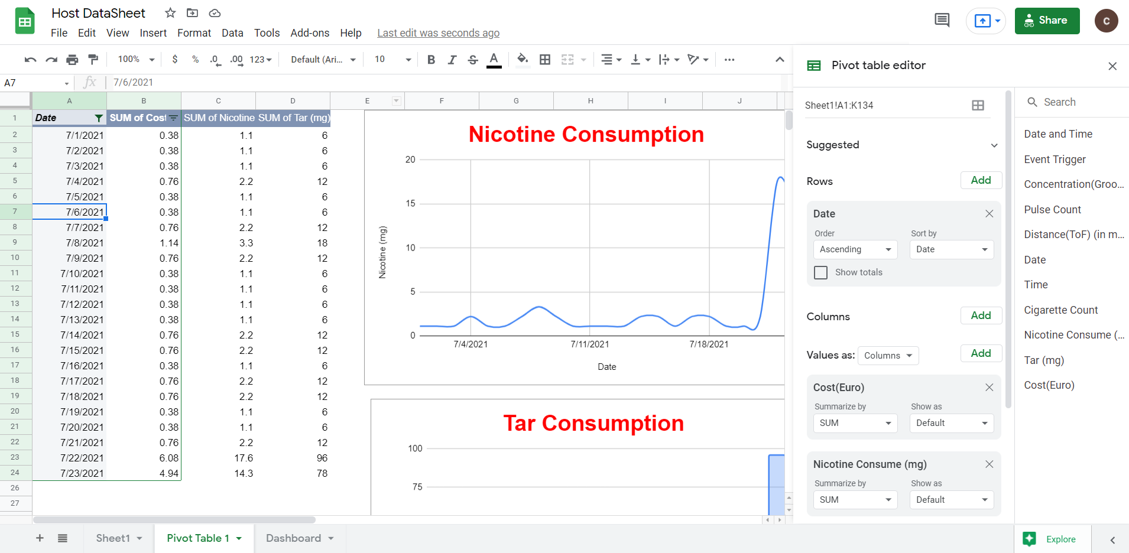
Cloud Integration Cont..
4. Data Sent to Cloud, Formatted and presented to end-user

Slide 27
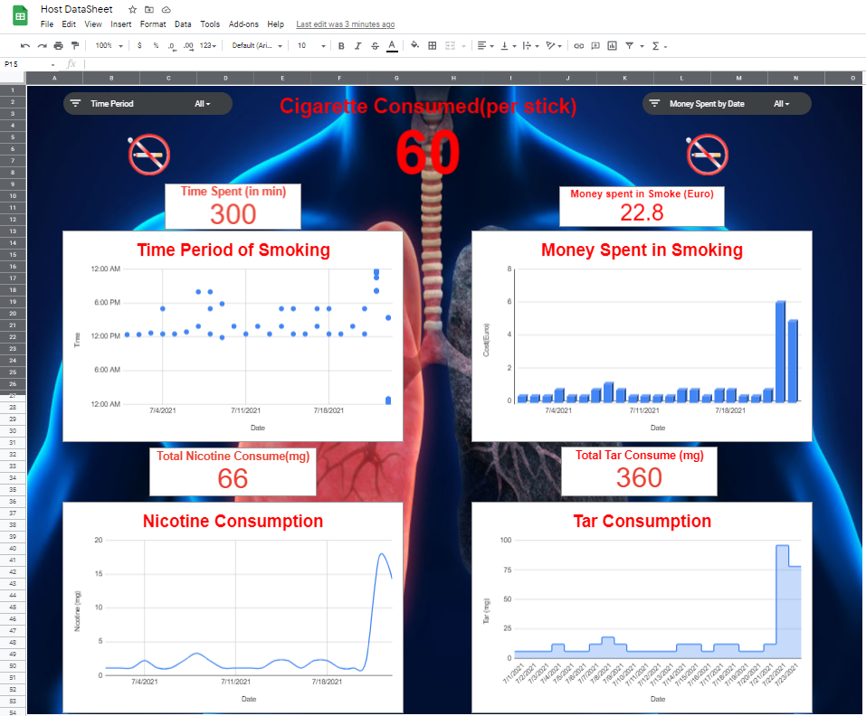
Cloud Integration Cont..
4. Data Sent to Cloud, Formatted and presented to end-user
Dashboard Link- https://ift.tt/3zrYY56

Slide 28
void setup()
{
M5.begin();
Serial.begin(115200);
WiFi.begin(ssid, password);
Serial.println("Connecting");
while (WiFi.status() != WL_CONNECTED)
{
delay(500);
Serial.print(".");
}
Serial.println("");
Serial.print("Connected to WiFi network with IP Address: ");
Serial.println(WiFi.localIP());
generateSmokeDetector();
#ifdef SIM
generateSmokeSim();
sim1->start(millis());
#else
pinMode(smkPin, INPUT);
pinMode(hrPin, INPUT);
gpio_pulldown_dis(GPIO_NUM_25);
// ToF
// wait until serial port opens for native USB devices
while(!Serial) delay(1);
Serial.println("Adafruit VL53L0X test");
if (!lox.begin(0x29, true)) {
Serial.println("Failed to boot VL53L0X");
while(1);
}
#endif
}

Slide 29
void loop()
{
#ifdef SIM
sim1->step(millis());
curTime = sim1->getTime();
#else
curTime = millis();
#endif
getConc();
getDist();
getHR();
#ifdef SIM
delay(100); //needed for simulator
#endif
}

Slide 30
void getConc()
{
#ifndef SIM
auto dur = pulseIn(smkPin, LOW);
lowPulseOccupancy += dur;
#endif
if(curTime - prevSmokeRead >= smokeReadPeriod)
{
double conc = 0.0;
#ifdef SIM
conc = sim1->getCurSmoke();
#else
float ratio = lowPulseOccupancy/(smokeReadPeriod*10.0);
conc = 1.1*pow(ratio, 3) - 3.8*pow(ratio, 2) + 520 * ratio + 0.62; // using spec sheet curve
lowPulseOccupancy = 0;
#endif
printTime();
Serial.printf("Concentration: %.2f\n", conc );
det1->setConc(conc, curTime);
prevSmokeRead = curTime;
}
}
void getDist()
{
if(curTime - prevDistRead >= distReadPeriod)
{
unsigned short dist = 0xffff;
#ifdef SIM
dist = sim1->getCurDist();
#else
VL53L0X_RangingMeasurementData_t measure;
lox.rangingTest(&measure, false); // pass in 'true' to get debug data printout!
if(measure.RangeStatus != 4)
{
dist = measure.RangeMilliMeter;
}
#endif
printTime();
Serial.printf("Distance: %hu\n", dist );
det1->setDist(dist, curTime);
prevDistRead = curTime;
}
}
void getHR()
{
if(curTime - prevHRRead >= hrReadPeriod)
{
unsigned short hr = 0;
#ifdef SIM
hr = sim1->getCurHR();
#else
auto hrVal = analogRead(36);
if(hrVal < hrMax ) hr = hrVal;
#endif
printTime();
Serial.printf("Heart Rate: %hu\n", hr );
det1->setHR(hr, curTime);
prevHRRead = curTime;
}
}

Slide 31
struct SmokeDetectorSettings
{
double concTH;//concentration threshold
unsigned short HRTH;//Heart Rate threshold
unsigned short distTH;//Distance threshold
unsigned long waitTime;//Time between smokes
};
//callback type for detection
typedef void (*detect_t)(unsigned long, double, unsigned short, unsigned short);

Slide 32
class SmokeDetector{
SmokeDetector(SmokeDetectorSettings settings_, detect_t detectCB_ ) : settings(settings_), detectCB(detectCB_){}
void setConc(double conc_, unsigned long time){
conc = conc_;
isConcSet = true;
analyze(time);} void setHR(unsigned short hr_, unsigned long time){
hr = hr_;
isHRSet = true;
analyze(time);} void setDist(unsigned short dist_, unsigned long time){
dist = dist_;
isDistSet = true;
analyze(time);} void analyze(unsigned long time)
{ //check if there is sufficient data
if(!isConcSet || !isHRSet || !isDistSet ) return;
//check if it's too soon
if( detected && (time - lastDetected) < settings.waitTime ) return;
//check if smoking
if( (conc >= settings.concTH)
&& (dist <= settings.distTH)
&& (hr >= settings.HRTH) )
{
detected = true;
lastDetected = time;
detectCB(time, conc, hr, dist);
}
}
SmokeDetectorSettings settings;
detect_t detectCB;
double conc;
unsigned short hr;
unsigned short dist;
bool isConcSet = false;
bool isHRSet = false;
bool isDistSet = false;
bool detected = false;
unsigned long lastDetected;

Slide 33
void myCB(unsigned long time, double conc,
unsigned short hr, unsigned short dist)
{
printTime();
Serial.printf("DETECTED.\n");
Serial.printf("Concencration: %.2f, Heart Rate: %hu, Distance: %hu\n", conc, hr, dist);
send2ifttt(conc, hr, dist);
}

Slide 34
void send2ifttt(double conc, unsigned short hr,
unsigned short dist){
if(WiFi.status() != WL_CONNECTED)
{
Serial.println("WiFi Disconnected");
return;
}
char buf[256];
sprintf(buf, "https://maker.ifttt.com/trigger/%s/with/key/%s?value1=%.2f&value2=%hu&value3=%hu",
event, iftttApiKey, conc, hr, dist );
String jsonBuffer = httpGETRequest(buf);
Serial.println(jsonBuffer);
}

Slide 35
Takeaway
Learned from the Project.
Challenges faced.
Modification on the project.
Scale out of 10.
Product at production.

